Slide 1

Exploratory Data Analysis-2
(Data Visualization & Feature Exploration)
Today’s Agenda
Univariate Analysis
Bivariate Analysis
Correlation & Heatmaps
Distribution Plots
Feature Engineering Intro
Hands-On Practice
Kahoot(Quiz)

Slide 2
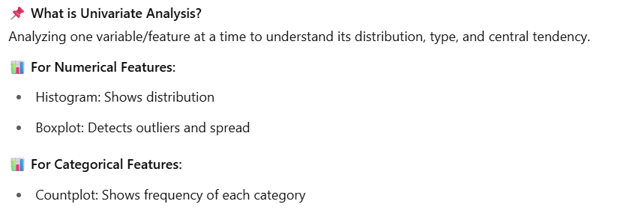
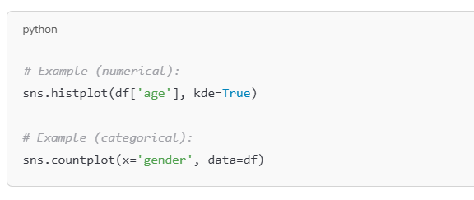
Univariate Analysis – Understanding
One Feature at a Time

Slide 3
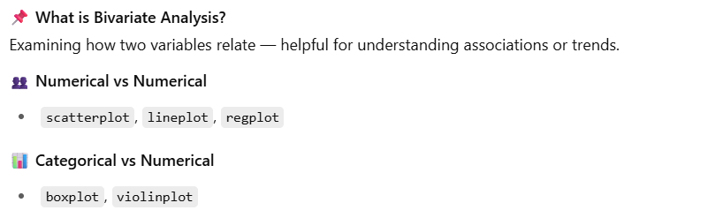
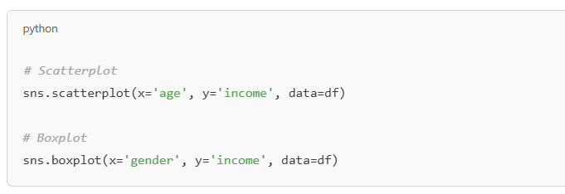
Bivariate Analysis – Relationships
Between Two Features
Covid death correlation is an example of Bivariate Analysis(Positive response)
A scatter plot is used to indicate positive or negative values.

Slide 4
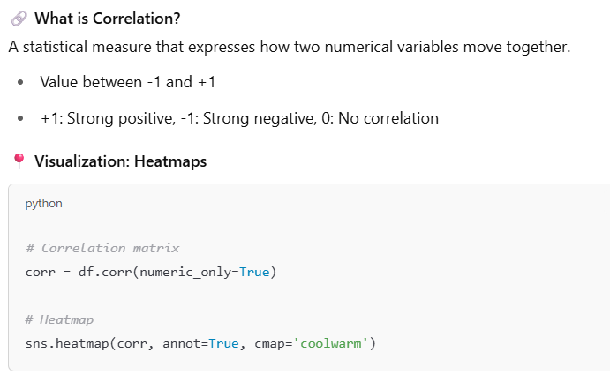
Correlation and Heatmaps

Slide 5
Short break

Slide 6
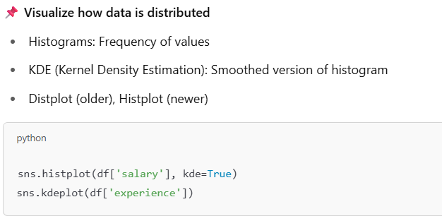
Distribution & Density Plots

Slide 7
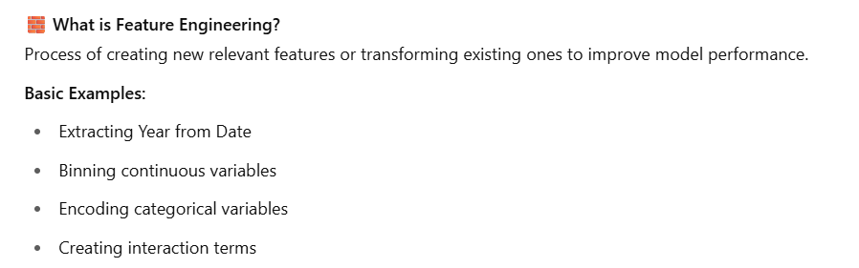
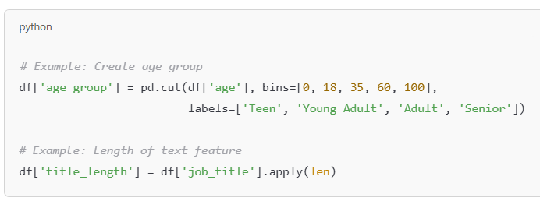
Feature Engineering Introduction
Laten space
encoding

Slide 8
Main Break

